Slide 1
ONLINE BOOK STORE
Presented By:
- SAMEER BORKAR(1134)
-MAYUR MOHURLE(1158)

Slide 2
CONTENTS
Objectives
Client Side Requirements
Functional Requirements
Data Flow Diagrams
Entity Relationship Diagrams
Database structures
Outputs/Screen shots
Limitations/Drawbacks
Future scope

Slide 3
OBECTIVES
The main objective of “Online Book Store” is to provide an essence of online book store via a lucid, simple and yet powerful interface.
The site is designed principally keeping a wide range of users in mind and hence the interface as well as the various procedures have been so designed that they can be used comfortably by all sorts of users.
The project has been designed to simulate the working of an actual online book store.

Slide 4
CLIENT SIDE REQUIREMENTS
Hardware requirements(min.)
512 MB of RAM
P-IV processor or higher.
Software Requirements(min.)
Web Browser like Internet Explorer 6.0(and above),Mozilla Firefox,Opera 10.60,Google Chrome or others..
OPErating system
Windows XP or later.
Linux or any other OS.

Slide 5
FUNCTIONAL REQUIREMENTS
Browse Books
An user logging into the site can browse through the books both by category or in a random manner.
View Details
An user can also view the details of the book(eg:price,author) as well as a short excerpt from the book.
Add to Cart
The user can add the books of his choice to the shopping cart.
Make Payments
The user ultimately visits his cart and makes the payment.

Slide 6
USECASE DIAGRAMS
Following Slides Contains Database Structure

Slide 7
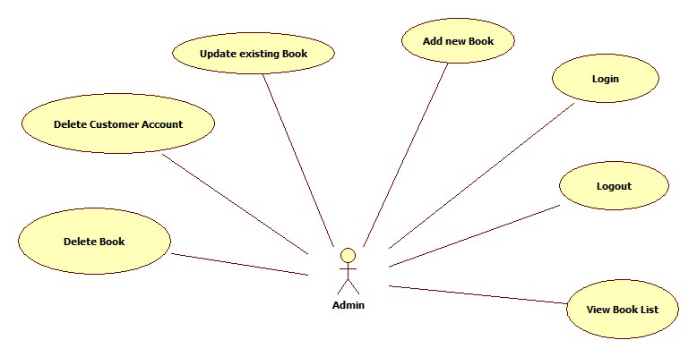

Slide 8
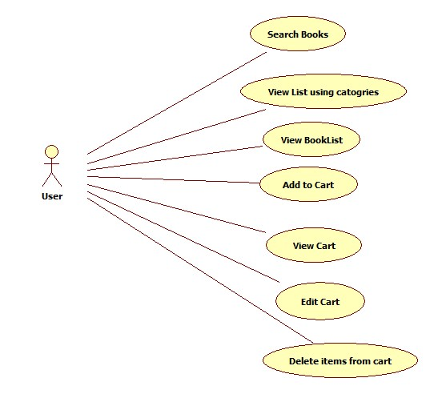

Slide 9
DATA FLOW DIAGRAMS
The following section contains the Data Flow Diagrams for the proposed system.

Slide 10
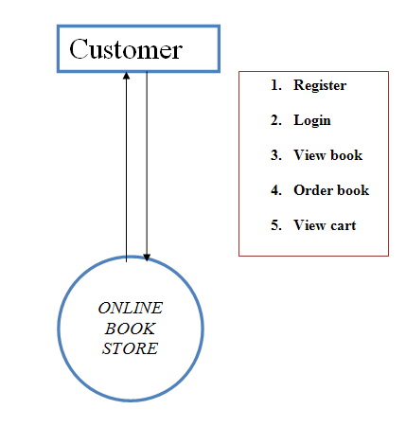

Slide 11
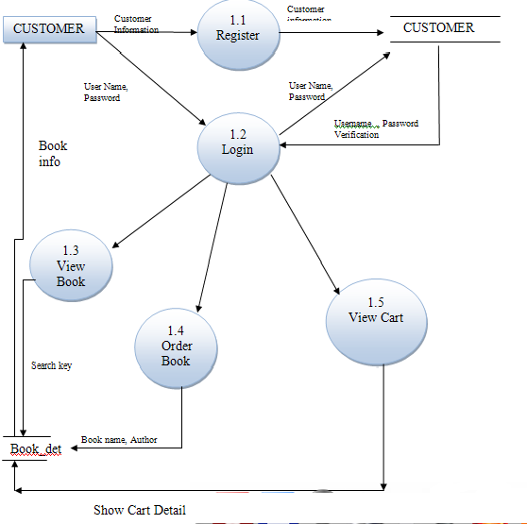

Slide 12
ENTITY RELATIONSHIP DIAGRAMS
The following section contains an ERD of the proposed project

Slide 13
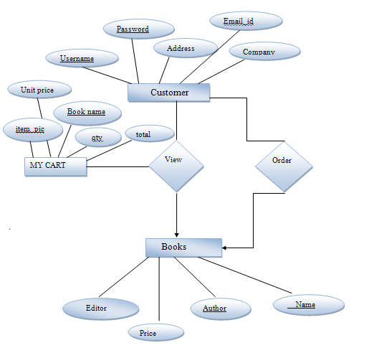

Slide 14
DATABASE STRUCTURE
Following Slides Contains Database Structure

Slide 15
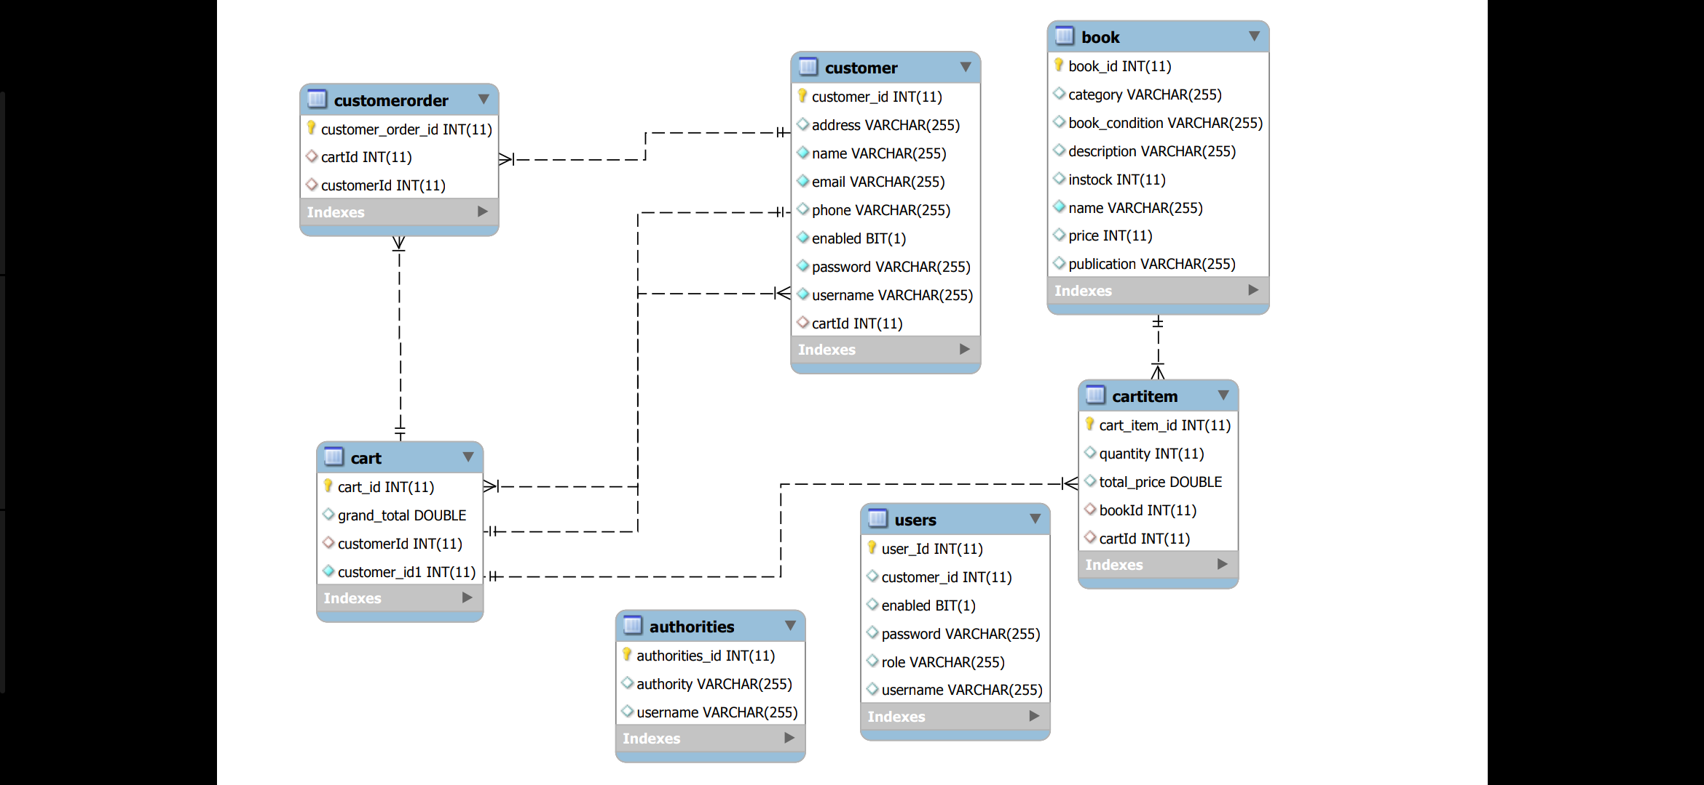

Slide 16
Limitations and Drawbacks
The project though an interesting one has a few limitations. They are as follows:
i)The project doesn’t store the transactions at this particular moment. So a buyer will not be able to make references to any past transcations.
ii)The categorization panel has to be a little more intuitive and user friendly.

Slide 17
FUTURE SCOPE
The project is just a prototype and has immense areas of development. The areas of development are as follows:
i) The web application should be able to remember the preferences of a user like remembering his billing and shipping address.
ii)The web application should tie up with the “verified by visa” and “VeriSign” organizations for far more secure transactions.

Slide 18
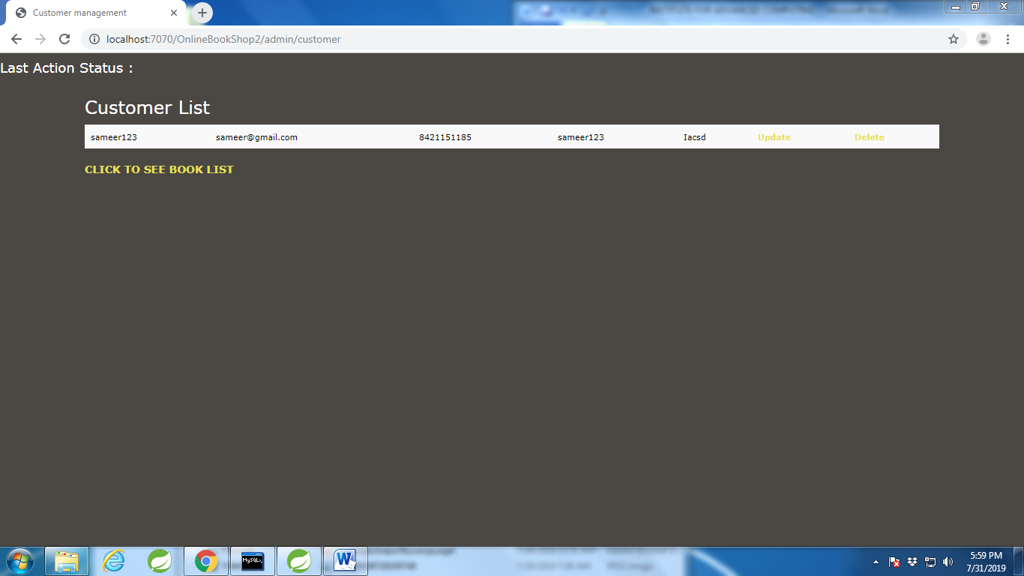

Slide 19
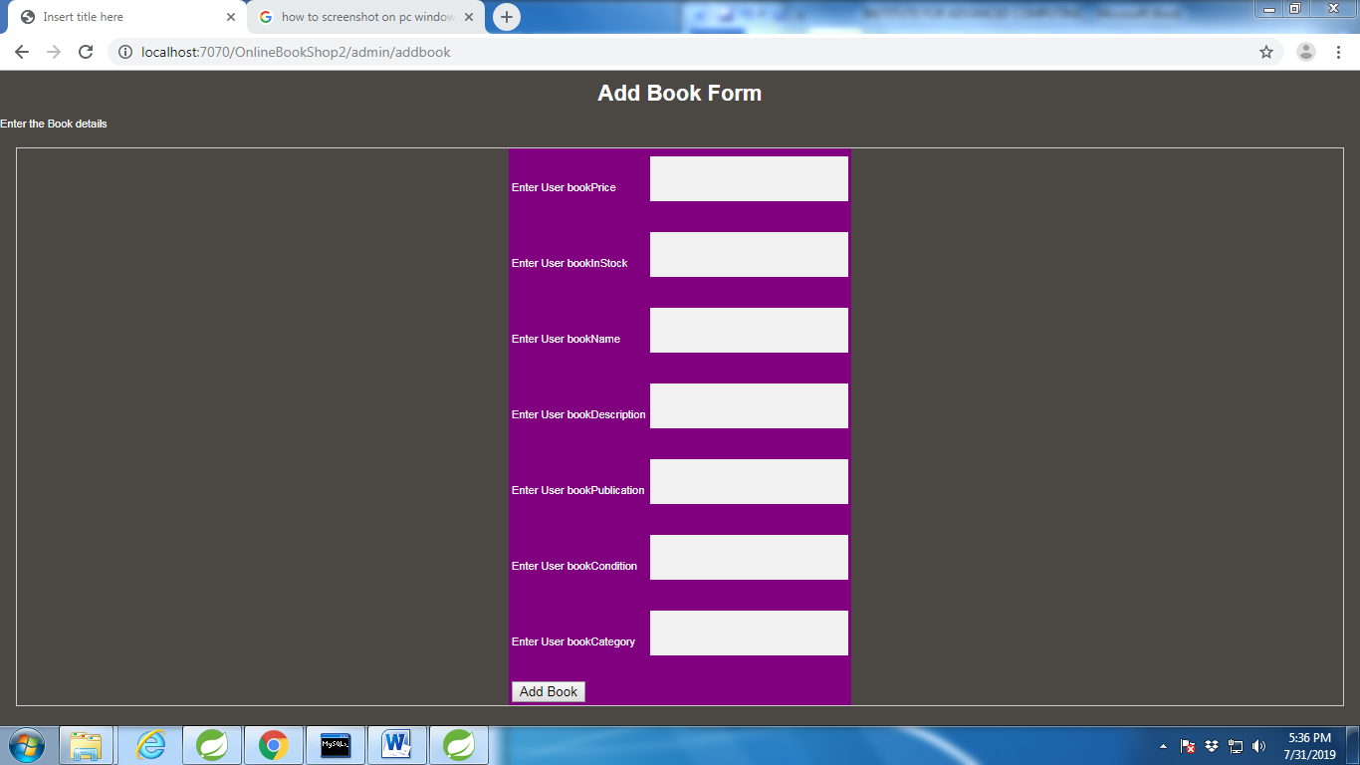

Slide 20
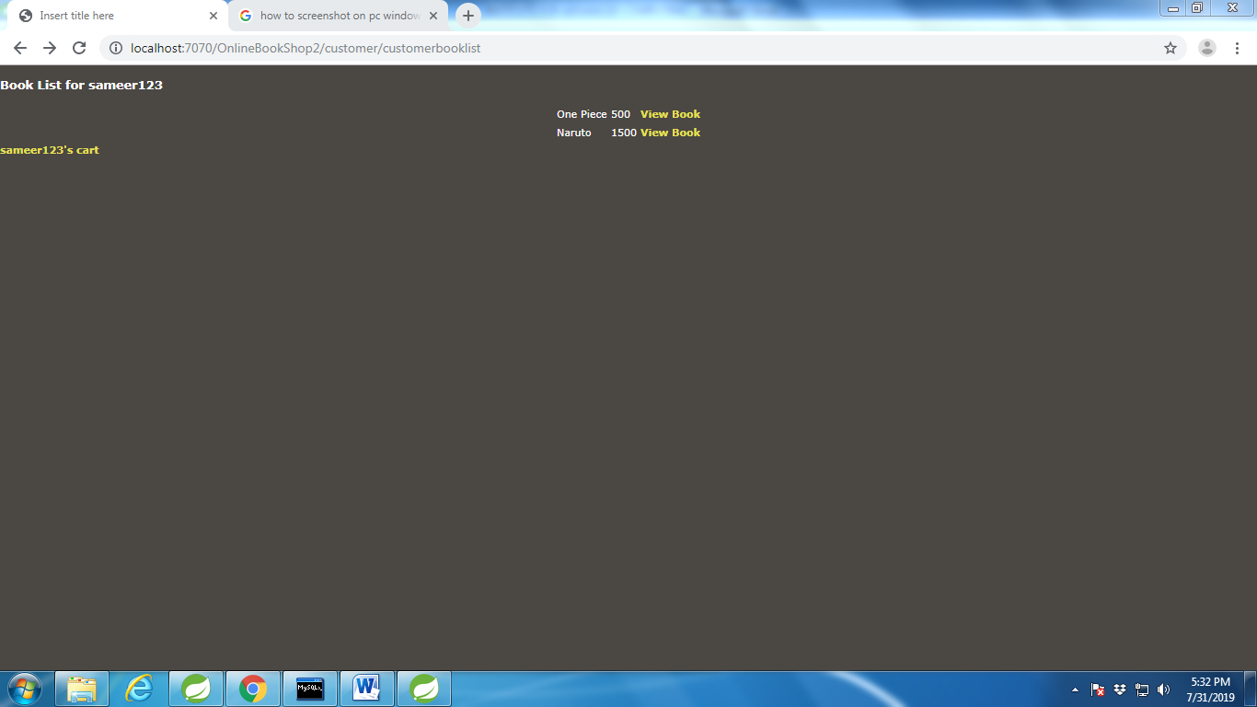

Slide 21
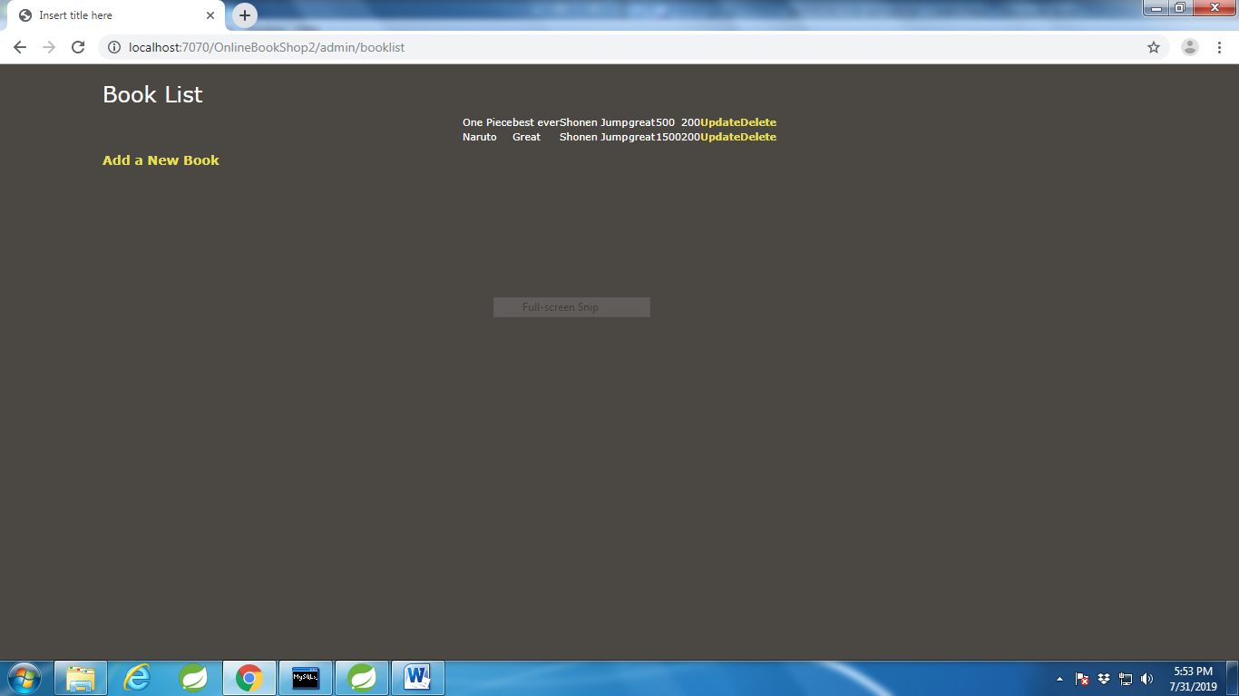

Slide 22
THANK YOU

